Slide 1
ROUTING
---- OYSHEE BHATTACHARJEE
Roll No -16800117038
3rd Year (CSE)

Slide 2
CONTENTS
What is routing?
Why do we need it?
A little background first..!!!
The OSI model of Telecommunication.
TCP vs UDP : Understanding the difference.
Collision Domain and Broadcast Domain
Hubs, switches and routers – are they same?
ARP : How do machines get to know each other..?

Slide 3
CONTENTS
Routing Tables
Routing Protocols: How data packets roam about...?

Slide 4
What is routing?

Slide 5
In simpler terms…
Routing is the process of dispatching information packets where they need to go.
In other words, it is a process of moving data from one host computer to another.
A host is essentially anything on the network that is capable of receiving and transmitting IP packets on the network, such as a workstation or a router.

Slide 6
Why do we need it?

Slide 7
you control the routers, you control the network…!!!
Routing establishes basic inter-network communications, implements an addressing structure that uniquely identifies each device, and organizes individual devices into a hierarchical network structure.
Routers can be thought of as the integration platforms for a wide variety of network enhancements such as security, policy, and services that extend the capabilities of IP to support telephony, video, legacy service integration, and other applications over a converged network.
The router has thus become the primary control point in the increasingly complex network environment.

Slide 8
A little background first..!!!

Slide 9
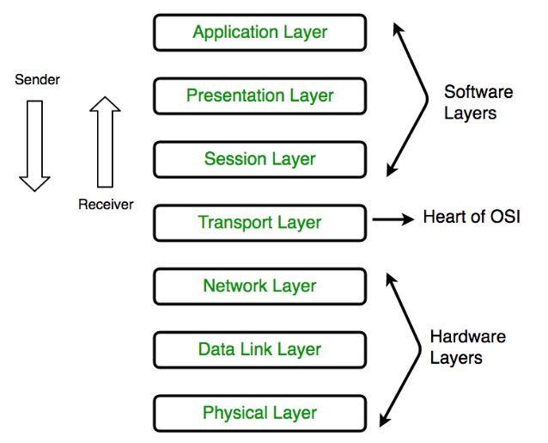
The OSI model of Telecommunication.
1. Physical Layer (Layer 1) :
The lowest layer of the OSI reference model is the physical layer. It is responsible for the actual physical connection between the devices. The physical layer contains information in the form of bits. It is responsible for transmitting individual bits from one node to the next. When receiving data, this layer will get the signal received and convert it into 0s and 1s and send them to the Data Link layer, which will put the frame back together.
Hub, Repeater, Modem, Cables are Physical Layer devices.
Network Layer, Data Link Layer and Physical Layer are also known as Lower Layers or Hardware Layers.

Slide 10
The OSI model of Telecommunication.
2. Data Link Layer (DLL) (Layer 2) :
The data link layer is responsible for the node to node delivery of the message. The main function of this layer is to make sure data transfer is error-free from one node to another, over the physical layer. When a packet arrives in a network, it is the responsibility of DLL to transmit it to the Host using its MAC address.

Slide 11
The OSI model of Telecommunication.
3. Network Layer (Layer 3) :
Network layer works for the transmission of data from one host to the other located in different networks. It also takes care of packet routing i.e. selection of the shortest path to transmit the packet, from the number of routes available. The sender & receiver’s IP address are placed in the header by the network layer.The functions of the Network layer are :
Routing: The network layer protocols determine which route is suitable from source to destination. This function of network layer is known as routing.
Logical Addressing: In order to identify each device on internetwork uniquely, network layer defines an addressing scheme. The sender & receiver’s IP address are placed in the header by network layer. Such an address distinguishes each device uniquely and universally.
Segment in Network layer is referred as Packet.
Network layer is implemented by networking devices such as routers.

Slide 12
The OSI model of Telecommunication.
4. Transport Layer (Layer 4) :
Transport layer provides services to application layer and takes services from network layer. The data in the transport layer is referred to as Segments. It is responsible for the End to End Delivery of the complete message. The transport layer also provides the acknowledgement of the successful data transmission and re-transmits the data if an error is found. The functions of the transport layer are :
Segmentation and Reassembly: This layer accepts the message from the (session) layer , breaks the message into smaller units . Each of the segment produced has a header associated with it. The transport layer at the destination station reassembles the message.
Service Point Addressing: In order to deliver the message to correct process, transport layer header includes a type of address called service point address or port address. Thus by specifying this address, transport layer makes sure that the message is delivered to the correct process.

Slide 13
The OSI model of Telecommunication.
5. Session Layer (Layer 5) :
This layer is responsible for establishment of connection, maintenance of sessions, authentication and also ensures security. The functions of the session layer are :
Session establishment, maintenance and termination: The layer allows the two processes to establish, use and terminate a connection.
Synchronization : This layer allows a process to add checkpoints which are considered as synchronization points into the data. These synchronization point help to identify the error so that the data is re-synchronized properly, and ends of the messages are not cut prematurely and data loss is avoided.
Dialog Controller : The session layer allows two systems to start communication with each other in half-duplex or full-duplex.

Slide 14
The OSI model of Telecommunication.
6. Presentation Layer (Layer 6) :
Presentation layer is also called the Translation layer.The data from the application layer is extracted here and manipulated as per the required format to transmit over the network. The functions of the presentation layer are :
Translation : For example, ASCII to EBCDIC.
Encryption/ Decryption : Data encryption translates the data into another form or code. The encrypted data is known as the cipher text and the decrypted data is known as plain text. A key value is used for encrypting as well as decrypting data.
Compression: Reduces the number of bits that need to be transmitted on the network.

Slide 15
The OSI model of Telecommunication.
7. Application Layer (Layer 7) :
At the very top of the OSI Reference Model stack of layers, we find Application layer which is implemented by the network applications. These applications produce the data, which has to be transferred over the network. This layer also serves as a window for the application services to access the network and for displaying the received information to the user.
Application Layer is also called as Desktop Layer.
The functions of the Application layer are :
Network Virtual Terminal
FTAM-File transfer access and management
Mail Services
Directory Services

Slide 16
TCP vs. UDP : Understanding the difference.
Transmission Control Protocol (TCP) is a connection-oriented protocol that computers use to communicate over the internet. It is one of the main protocols in TCP/IP networks. TCP provides error-checking and guarantees delivery of data and that packets will be delivered in the order they were sent.
User Datagram Protocol (UDP) is a connectionless protocol that works just like TCP but assumes that error-checking and recovery services are not required. Instead, UDP continuously sends datagrams to the recipient whether they receive them or not.
TCP is reliable. Data sent using a TCP protocol is guaranteed to be delivered to the receiver. If data is lost in transit it will recover the data and resend it. TCP will also check packets for errors and track packets so that data is not lost or corrupted. UDP is unreliable, it does not provide guaranteed delivery and a datagram packet may become corrupt or lost in transit.

Slide 17
TCP vs. UDP : Understanding the difference.
TCP is best suited to be used for applications that require high reliability where timing is less of a concern.
World Wide Web (HTTP, HTTPS)
Secure Shell (SSH)
File Transfer Protocol (FTP)
Email (SMTP, IMAP/POP)
UDP is best suited for applications that require speed and efficiency.
VPN tunneling
Streaming videos
Online games
Live broadcasts
Domain Name System (DNS)
Voice over Internet Protocol (VoIP)
Trivial File Transfer Protocol (TFTP)

Slide 18
Collision Domain and Broadcast Domain
Collision Domain – A Collision Domain is a scenario in which when a device sends out a message to the network, all other devices which are included in its collision domain have to pay attention to it, no matter if it was destined for them or not. This causes a problem because, in a situation where two devices send out their messages simultaneously, a collision will occur leading them to wait and re-transmit their respective messages, one at a time. It happens only in case of a half-duplex mode.

Slide 19
Collision Domain and Broadcast Domain
Broadcast Domain – A Broadcast Domain is a scenario in which when a device sends out a broadcast message, all the devices present in its broadcast domain have to pay attention to it. This creates a lot of congestion in the network, commonly called LAN congestion, which affects the bandwidth of the users present in that network. From this, one can realize that more the number of collision domains and more the number of broadcast domains, the more efficient is the network providing better bandwidth to all its users.

Slide 20
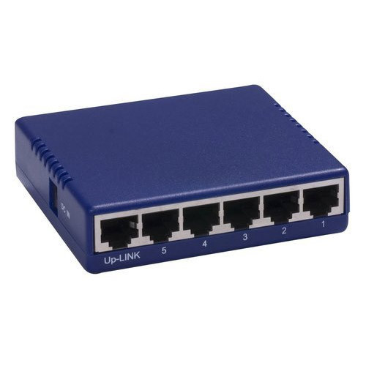
Hubs, switches and routers – are they same?
HUB:
A non-intelligent device. It doesn’t segment a network, rather just connects network segments.
It has 1 collision domain and 1 broadcast domain.

Slide 21
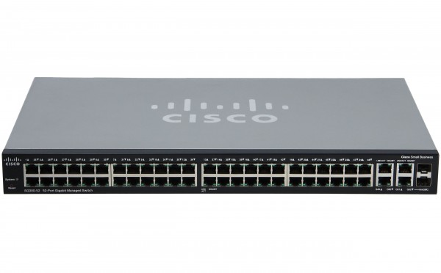
Hubs, switches and routers – are they same?
SWITCH:
An intelligent device. It has ASIC (Application-specific integrated circuit) which enables it to store MAC addresses of devices connected to it
It has many collision domains (=number of ports) and 1 broadcast domain.

Slide 22
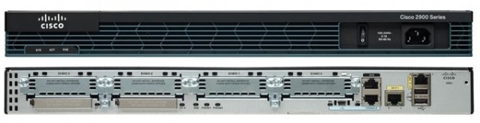
Hubs, switches and routers – are they same?
ROUTER:
An intelligent device. It has ASIC (Application-specific integrated circuit) which enables it to store MAC addresses of devices connected to it
A router creates a connection between two networks.
It has many collision domains and many broadcast domains (=number of ports). A broadcast message from one network will never reach the other one as the router will drop the packet and never let it pass.

Slide 23
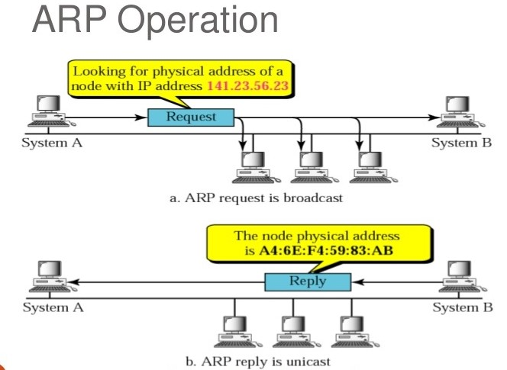
ARP : How do machines get to know each other..?
The acronym ARP stands for Address Resolution Protocol which is one of the most important protocols of the Data link layer (Layer 2) in the OSI model.
ARP finds the hardware address, also known as Media Access Control (MAC) address, of a host from its known IP address.

Slide 24
ARP : How do machines get to know each other..?
SOME GENERIC TERMS:-
ARP Cache: After resolving MAC address, the ARP sends it to the source where it stores in a table for future reference. The subsequent communications can use the MAC address from the table
ARP Cache Timeout: It indicates the time for which the MAC address in the ARP cache can reside
ARP request: This is nothing but broadcasting a packet over the network to validate whether we came across destination MAC address or not.
ARP request packet contains:The physical address of the sender.
The IP address of the sender.
The physical address of the receiver is 0s.
The IP address of the receiver
The ARP packet is encapsulated directly into data link frame.
ARP response/reply: It is the MAC address response that the source receives from the destination which aids in further communication of the data.

Slide 25
ARP : How do machines get to know each other..?
Let’s say a device wants to communicate with another having an IP address 141.23.56.23. The steps included in ARP process will be as follows :-
The source ARP cache is checked to determine whether the ARP is resolved or not. If the ARP is not resolved, it puts the packet on hold and generates an ARP request. If the ARP is already resolved then the packet will be delivered to destination host.

Slide 26
ARP : How do machines get to know each other..?
The ARP request is broadcast all over the network to find out the device having destination IP address. If the destination is present in the same network then ARP will find out destination MAC address but if it is present in different network then ARP will find out default gateway MAC address.
When the device having the destination IP address receives the ARP request, it updates it’s own ARP cache.
The destination host machine generates an ARP reply containing it’s own MAC address.
Now, the device having the source IP address receives the ARP reply and update it’s ARP cache.

Slide 27
Routing Tables

Slide 28
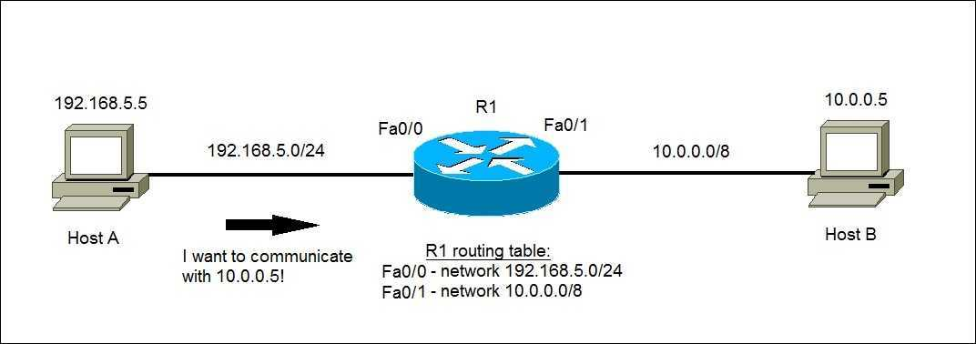
In a broader sense…
A routing table is a set of rules, often viewed in table format, that is used to determine where data packets traveling over an Internet Protocol (IP) network will be directed. All IP-enabled devices, including routers and switches, use routing tables.
When a router receives a packet, it examines the destination IP address, and looks up into its Routing Table to figure out which interface packet will be sent out.

Slide 29
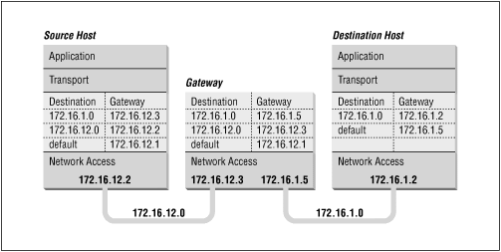
How are routing tables populated..?
There are ways to maintain Routing Table:
Directly connected networks are added automatically.
Using Static Routing.
Using Dynamic Routing.
These Routing tables can be maintained manually or dynamically. In dynamic routing, devices build and maintain their routing tables automatically by using routing protocols to exchange information about the surrounding network topology. Dynamic routing tables allow devices to “listen” to the network and respond to occurrences like device failures and network congestion. Tables for static network devices do not change unless a network administrator manually changes them.

Slide 30
Routing Protocols:
How Data Packets Roam About...?

Slide 31
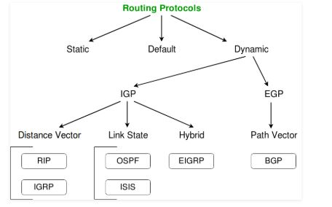
Types of Routing protocol
Routing protocols are mechanisms by which routing information is exchanged between routers so that routing decisions can be made.

Slide 32
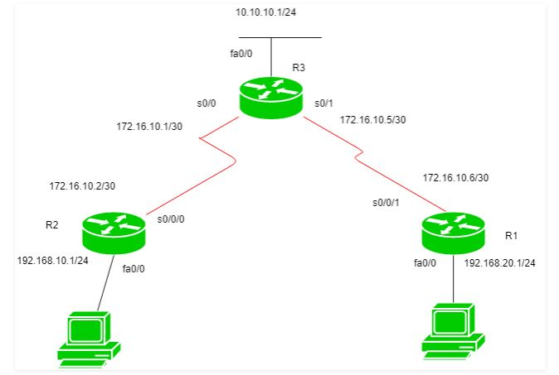
Static routing
Static routing is a process in which we have to manually add routes in routing table.
Advantages –
No routing overhead for router CPU which means a cheaper router can be used to do routing.
It adds security because only administrator can allow routing to particular networks only.
No bandwidth usage between routers.
Disadvantages –
For a large network, it is a hectic task for administrator to manually add each route for the network in the routing table on each router.
The administrator should have good knowledge of the topology. If a new administrator comes, then he has to manually add each route so he should have very good knowledge of the routes of the topology.

Slide 33
default routing
This is the method where the router is configured to send all packets towards a single router (next hop). It doesn’t matter to which network the packet belongs, it is forwarded out to router which is configured for default routing. It is generally used with stub routers. A stub router is a router which has only one route to reach all other networks.
In this topology, R1 and R2 are stub routers so one can configure default routing for both these routers.

Slide 34
dynamic routing
Dynamic routing makes automatic adjustment of the routes according to the current state of the route in the routing table. Dynamic routing uses protocols to discover network destinations and the routes to reach it. Automatic adjustment will be made to reach the network destination if one route goes down.
A dynamic protocol have following features:
The routers should have the same dynamic protocol running in order to exchange routes.
When a router finds a change in the topology then router advertises it to all other routers.
Advantages –
Easy to configure and more effective at selecting the best route to a destination remote network and also for discovering remote network.
Disadvantage –
Consumes more bandwidth for communicating with other neighbors.
Less secure than static routing.

Slide 35
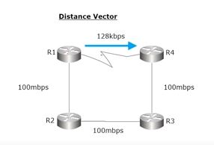
Distance Vector Routing Protocol
These protocols selects best path in the basis of hop counts to reach a destination network in the particular direction. Dynamic protocol like RIP is an example of distance vector routing protocol. Hop count is each router which occurs in between the source and the destination network. The path with the least hop count will be chosen as the best path.

Slide 36
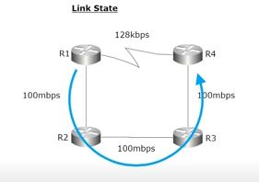
Link State Routing Protocol
These protocols know more about the Internet work than any other distance vector routing protocol. These are also known as SPF (Shortest Path First) protocol. OSPF is an example of link state routing protocol.
As it maintains separate tables for both best route and the backup routes ( whole topology) therefore it has more knowledge of the inter network than any other distance vector routing protocol.
Concept of triggered updates are used therefore no more unnecessary bandwidth consumption is seen like in distance vector routing protocol.
Partial updates are triggered when there is a topology change, not a full update like distance vector routing protocol where whole routing table is exchanged.

Slide 37
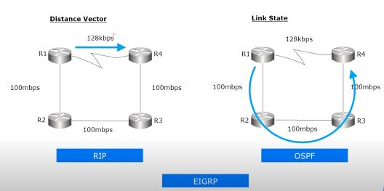
Advanced Distance vector routing protocol
It is also known as hybrid routing protocol which uses the concept of both distance vector and link state routing protocol. Enhanced Interior Gateway Routing Protocol (EIGRP) is an example of this class if routing protocol.
EIGRP acts as a link state routing protocol as it uses the concept of Hello protocol for neighbour discovery and forming adjacency. Also, partial updates are triggered when a change occurs.
EIGRP acts as distance vector routing protocol as it learned routes from directly connected neighbours.

Slide 38
References
CCNA Training Materials
Computer Networking: A Top-Down Approach

